Slide 1

Analysis on Prism+ Loyalty Scheme
Tolu Ogunlade​​
01/11/2024

Slide 2
Executive Summary
Prism Plus loyalty scheme was launched to enhance customer retention and drive revenue through tiered rewards, but financial outcomes show lower-than-expected performance.
Situation
A/B testing results across all loyalty tiers reveal no statistically significant increase in revenue, while high discount and shipping costs add further financial strain.
Revise the loyalty scheme's structure by adjusting discount rates, implementing targeted perks, and focusing on high-value customers to improve profitability and scheme impact.
Complication
Solution
8/05/20XX
Conference Presentation

Slide 3
Current scheme does not significantly influence Customer behaviour or Revenue
Bonze(control) Bronze(test)
P-score 0.077
P-score values
fail to reject the null hypothesis.
strongly fail to reject the null hypothesis
fail to reject the null hypothesis
fail to reject the null hypothesis
Silver(control) Silver(test)
P-score 0.74
Gold(control) Gold(test)
P-score 0.15
Platinum(control) platinum(test)
P-score 0.18
Conference Presentation

Slide 4
Low Profit and Revenue for Prism Plus Customers
Total Profit for Prism plus customers £166,750.80 for 2022
Total Revenue for Prism plus customers £512,290.95 for 2022
8/05/20XX
Conference Presentation

Slide 5
Discounts and free shipping on all tiers contribute to the loss of Revenue
Prism Plus tiers | Revenue | Revenue after discount
Bronze | £177,403.64 | £168,533.46
Silver | £110,574.92 | £99,517.43
Gold | £61,420.33 | £52,207.28
Platinum | £162,892.06 | £130,313.65
Total | £512,290.95 | £450,571.81
Revenue lost to Discounts £61,719.14
Total Shipping cost £24,930.62
8/05/20XX

Slide 6
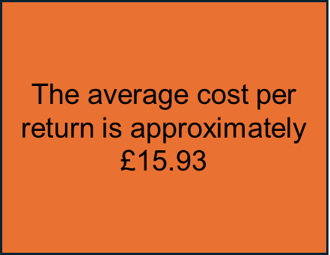
High return cost on items bought by Prism plus customers
Prism Plus tiers | Total items sold | Returned items | Return cost
Bronze | 9,822 | 1,910 | £33,133.90
Silver | 6,310 | 1,141 | £19,877.60
Gold | 3,594 | 707 | £11,345.9
Platinum | 9,919 | 1,987 | £27,112.20
Total | 29,645 | 5,745 | £91,469.60

Slide 7
Recommendations
Revise Discount Structure
Data Insight: Current discounts resulted in a revenue loss of £61,719.14 for 2022.
Recommendation: Consider reducing discount rates for lower tiers and introducing performance-based discounts for high-spending customers like Platinum with 5% discount for customers that spend £100 or more. This would reduce discount-related losses while rewarding top-tier members more strategically.
Optimize Shipping Costs
Data Insight: Total shipping cost for Prism Plus customers in 2022 was £24,930.62, directly impacting profit margins.
Recommendation Implement minimum spend thresholds for free shipping or shift to a shared-cost model for all but the highest loyalty tiers (Platinum tiers). This could help offset shipping expenses by approximately £7,762.04 and increase profitability.
Improve Tier-based Reward System
Data Insight: Total revenue for Prism Plus users was £512,290.95, compared to over £4 million from non-loyalty users in 2022.
Recommendation: Enhance tier-specific benefits to make the loyalty program more appealing, focusing on perks with high perceived value but low cost, such as exclusive access or limited-time offers.
Implement a Return Policy Review
Data Insight: With a total return cost of £91,469.60 from 11,744 customers and 5,745 items returned, the average cost per return is approximately £15.93.
Recommendation: Assess the current return policy to identify potential loopholes and areas for improvement. Consider tightening the return window, clarifying return conditions, or offering incentives for exchanges instead of returns.

Slide 8


Thank You
8/05/20XX

